Slide 1
COMP 590: Computer Architecture Lecture 1 - Introduction
Amogh Akshintala
Computer Science
University of North Carolina at Chapel Hill
https://aakshintala.com/
https://aakshintala.com/teaching/comp590-s20

Slide 2
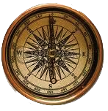
What is Computer Architecture?
Application
Gap too large to bridge in one step
(but there are exceptions, e.g. magnetic compass)
Physics
In its broadest definition, computer architecture is the design of the abstraction layers that allow us to implement information processing applications efficiently using available manufacturing technologies.

Slide 3
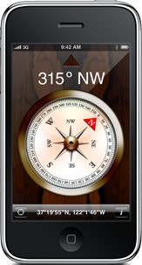
Abstraction Layers in Modern Systems
Application
Algorithm
Programming Language
Operating System/Virtual Machines
Instruction Set Architecture (ISA)
Microarchitecture
Gates/Circuits
Physics

Slide 4
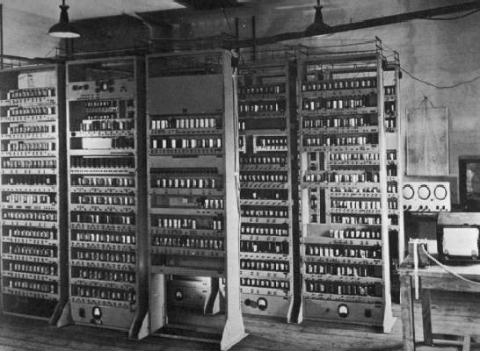
Computing Devices Then…
EDSAC, University of Cambridge, UK, 1949

Slide 5

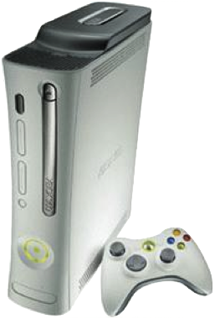
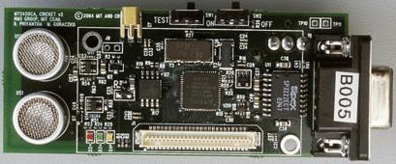
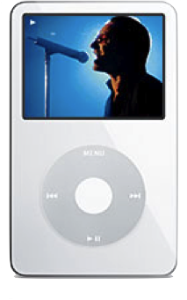
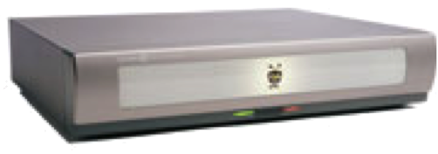
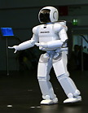
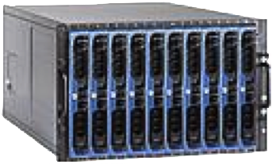
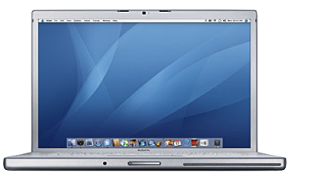
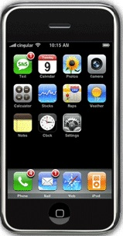
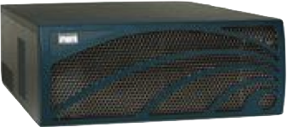
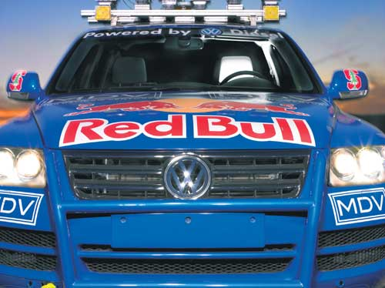
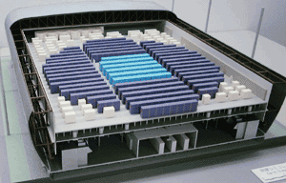
Computing Devices Now
Sensor Nets
Cameras
Games
Set-top boxes
Media Players
Laptops
Servers
Routers
Robots
Smart phones
Automobiles
Supercomputers

Slide 6
Architecture continually changing
Applications suggest how to improve technology, provide revenue to fund development
Improved technologies make new applications possible
Applications
Technology
Cost of software development makes compatibility a major force in market
Compatibility

Slide 7
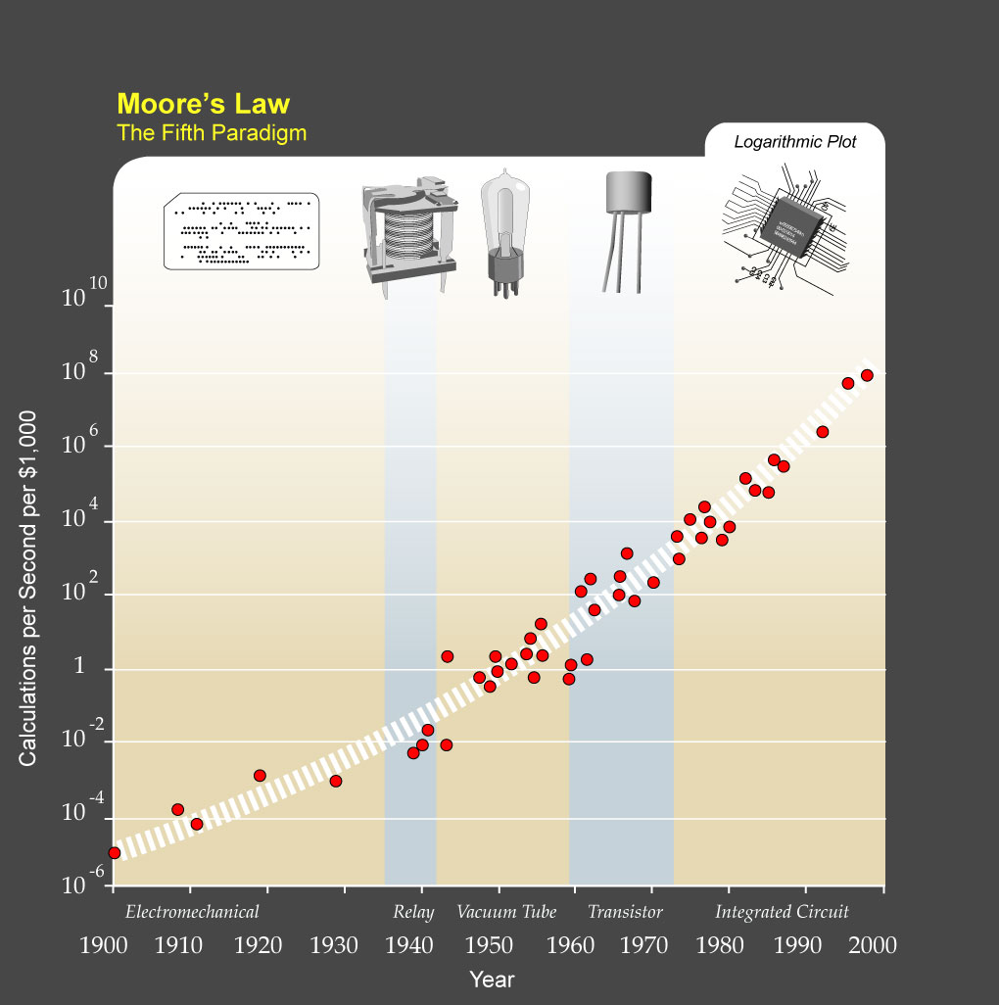
?
Major Technology Generations
CMOS
Bipolar
nMOS
Vacuum Tubes
pMOS
Relays
[from Kurzweil]
Electromechanical

Slide 8
Single-Thread Processor Performance
[ Hennessy & Patterson, 2017 ]

Slide 9
Upheaval in Computer Design
Most of last 50 years, Moore’s Law ruled
Technology scaling allowed continual performance/energy improvements without changing software model
Last decade, technology scaling slowed/stopped
Dennard (voltage) scaling over (supply voltage ~fixed)
Moore’s Law (cost/transistor) over?
No competitive replacement for CMOS anytime soon
Energy efficiency constrains everything
No “free lunch” for software developers, must consider:
Parallel systems
Heterogeneous systems

Slide 10
Today’s Dominant Target Systems
Mobile (smartphone/tablet)
>1 billion sold/year
Market dominated by ARM-ISA-compatible general-purpose processor in system-on-a-chip (SoC)
Plus sea of custom accelerators (radio, image, video, graphics, audio, motion, location, security, etc.)
Warehouse-Scale Computers (WSCs)
100,000’s cores per warehouse
Market dominated by x86-compatible server chips
Dedicated apps, plus cloud hosting of virtual machines
Now seeing increasing use of GPUs, FPGAs, custom hardware to accelerate workloads
Embedded computing
Wired/wireless network infrastructure, printers
Consumer TV/Music/Games/Automotive/Camera/MP3
Internet of Things!

Slide 11
COMP 590-154 Administrivia
Instructor: Amogh Akshintala, aakshintala@cs.unc.edu
Office: SN 305
Office Hours: Tu/Th. 3:30-5:00 PM or by appointment
Lectures: Tu/Th, 2:00-3:15 PM, SN 011
Text: Computer Architecture: A Quantitative Approach, Hennessey and Patterson, 6th Edition (2017)
Readings assigned from this edition, some readings available in older editions – see web page.
Web page: https://aakshintala.com/teaching/comp590-s20 Lectures available online by noon before class
Piazza: https://piazza.com/unc/spring2020/comp590154
Notes:
This slide is for the 3-min class administrative matters.
Make sure we update Handout #1 so it is consistent with this slide.

Slide 12
Course Grading
Score >100 points and you get an A.
All scores below 100 points will be curved.
Total 150 possible points:
Assignment 1 – 15
Assignment 2 – 15
Assignment 3 – 15
Assignment 4 – 15
Final Exam – 30 (you MUST show up and sign the coversheet even if you leave it blank)
Project – 50
Participation – 10

Slide 13
Questions?

Slide 14
Computer Architecture: A Little History
Throughout the course we’ll use a historical narrative to help understand why certain ideas arose
Why worry about old ideas?
Helps to illustrate the design process, and explains why certain decisions were taken
Because future technologies might be as constrained as older ones
Those who ignore history are doomed to repeat it
Every mistake made in mainframe design was also made in minicomputers, then microcomputers, where next?

Slide 15
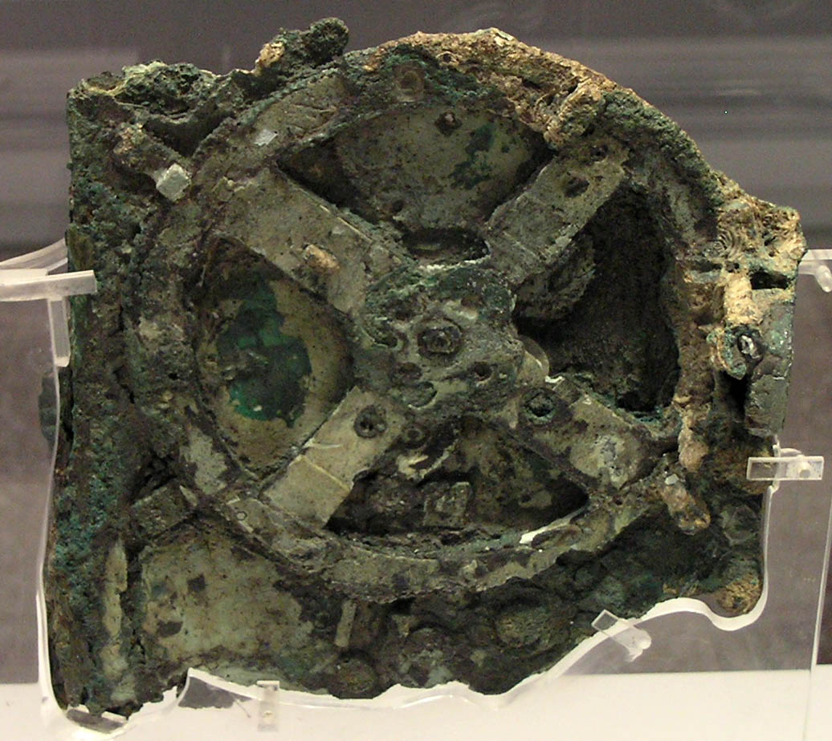
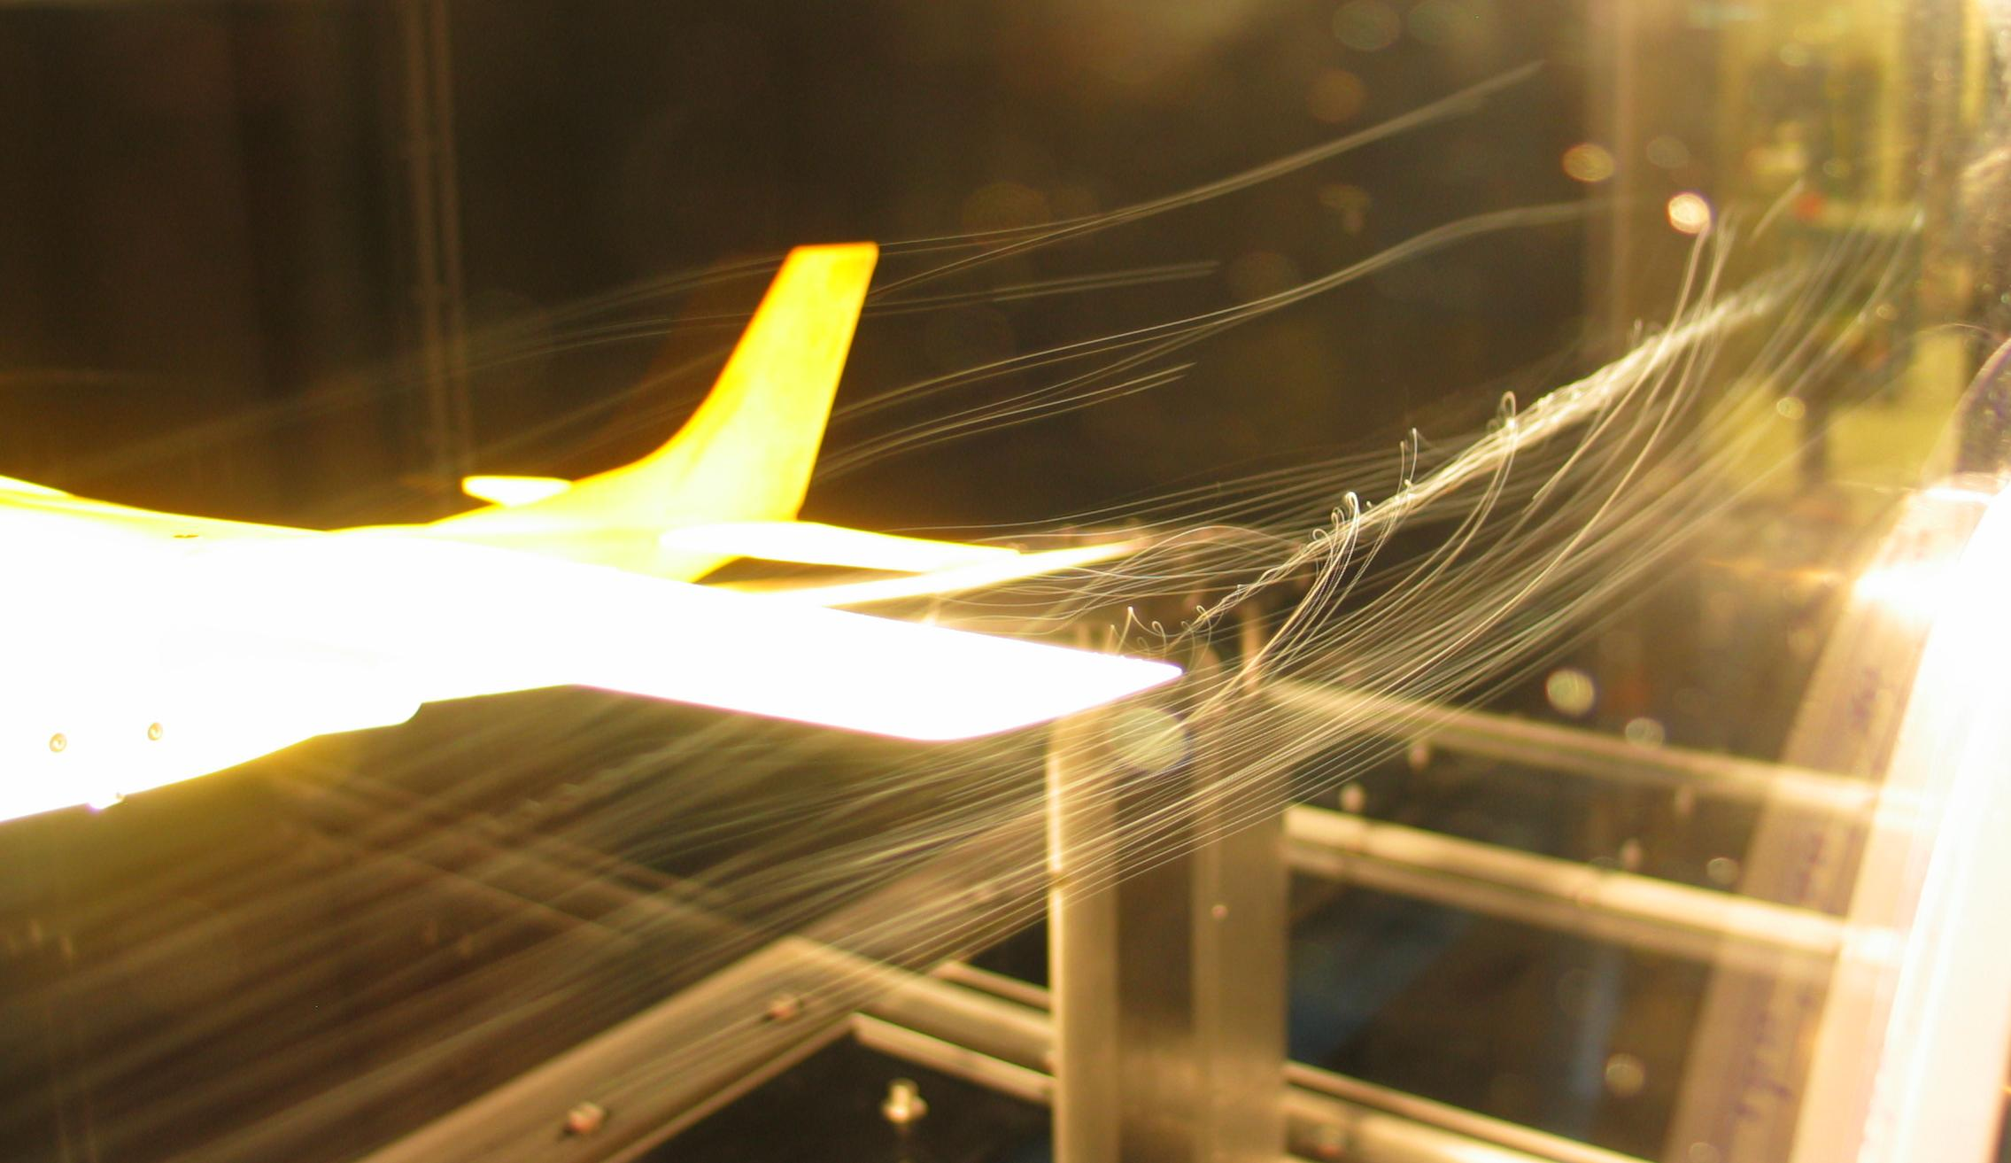
Analog Computers
Analog computer represents problem variables as some physical quantity (e.g., mechanical displacement, voltage on a capacitor) and uses scaled physical behavior to calculate results
[BenFrantzDale, Creative Commons BY-SA 3.0]
[Marsyas, Creative Commons BY-SA 3.0]
Wingtip vortices off Cesna tail in wind tunnel
Antikythera mechanism c.100BC

Slide 16
Digital Computers
Represent problem variables as numbers encoded using discrete steps
Discrete steps provide noise immunity
Enables accurate and deterministic calculations
Same inputs give same outputs exactly
Not constrained by physically realizable functions
Programmable digital computers are CSx52 focus

Slide 17
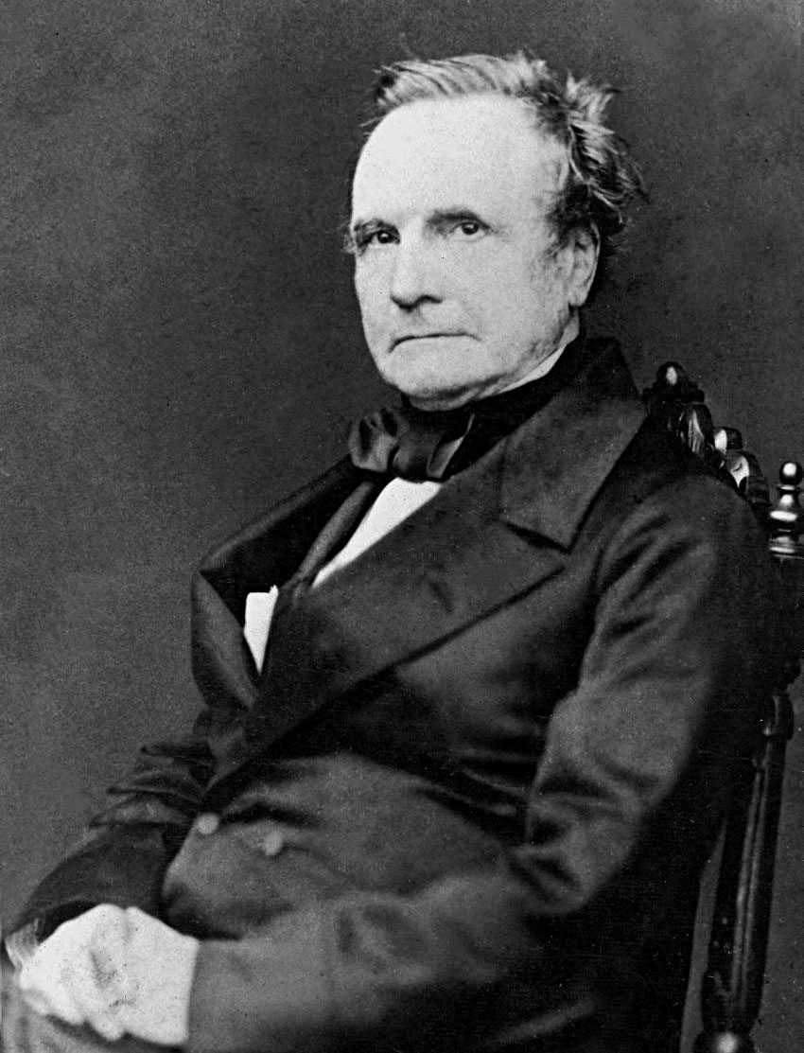
Charles Babbage (1791-1871)
Lucasian Professor of Mathematics, Cambridge University, 1828-1839
A true “polymath” with interests in many areas
Frustrated by errors in printed tables, wanted to build machines to evaluate and print accurate tables
Inspired by earlier work organizing human “computers” to methodically calculate tables by hand
[Copyright expired and in public domain.
Image obtained from Wikimedia Commons.]

Slide 18
Difference Engine 1822
Continuous functions can be approximated by polynomials, which can be computed from difference tables:
f(n) = n² + n + 41
d1(n) = f(n) – f(n-1) = 2n
d2(n) = d1(n) – d1(n-1) = 2
Can calculate using only a single adder:
n
0
1
2
3
4
d2(n)
2
2
2
d1(n)
2
4
6
8
f(n)
41
43
47
53
61

Slide 19
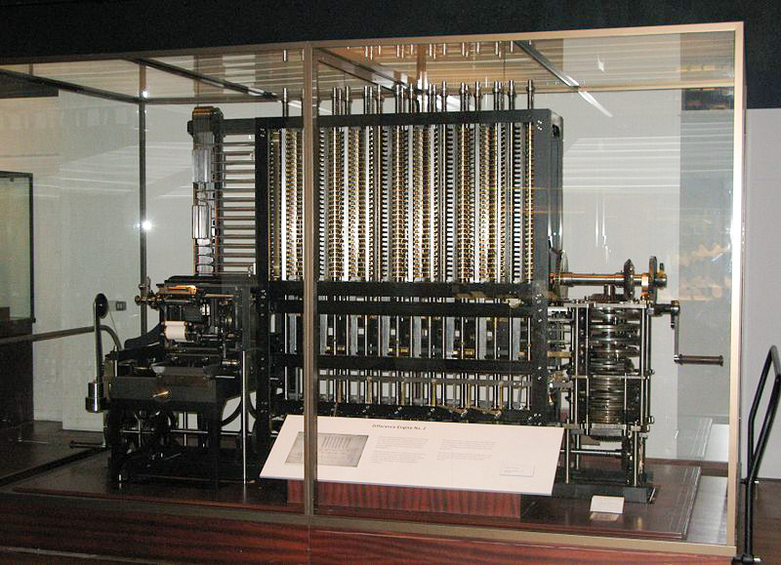
Realizing the Difference Engine
Mechanical calculator, hand-cranked, using decimal digits
Babbage did not complete the DE, moving on to the Analytical Engine (but used ideas from AE in improved DE 2 plan)
Schuetz in Sweden completed working version in 1855, sold copy to British Government
Modern day recreation of DE2, including printer, showed entire design possible using original technology
first at British Science Museum
copy at Computer History Museum in San Jose
[Geni, Creative Commons BY-SA 3.0 ]

Slide 20
Analytical Engine 1837
Recognized as first general-purpose digital computer
Many iterations of the design (multiple Analytical Engines)
Contains the major components of modern computers:
“Store”: Main memory where numbers and intermediate results were held (1,000 decimal words, 40-digits each)
“Mill”: Arithmetic unit where processing was performed including addition, multiplication, and division
Also supported conditional branching and looping, and exceptions on overflow (machine jams and bell rings)
Had a form of microcode (the “Barrel”)
Program, input and output data on punched cards
Instruction cards hold opcode and address of operands in store
3-address format with two sources and one destination, all in store
Branches implemented by mechanically changing order cards were inserted into machine
Only small pieces were ever built

Slide 21
Analytical Engine Design Choices
Decimal, because storage on mechanical gears
Babbage considered binary and other bases, but no clear advantage over human-friendly decimal
40-digit precision (equivalent to >133 bits)
To reduce impact of scaling given lack of floating-point hardware
Used “locking” or mechanical amplification to overcome noise in transferring mechanical motion around machine
Similar to non-linear gain in digital electronic circuits
Had a fast “anticipating” carry
Mechanical version of pass-transistor carry propagate used in CMOS adders (and earlier in relay adders)

Slide 22
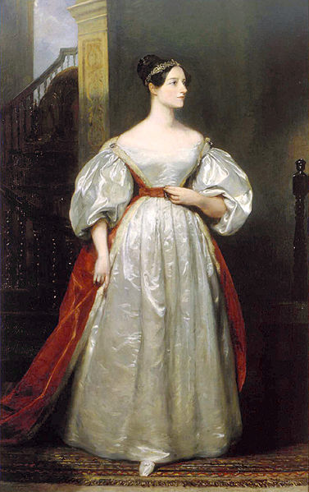
Ada Lovelace (1815-1852)
Translated lectures of Luigi Menabrea who published notes of Babbage’s lectures in Italy
Lovelace considerably embellished notes and described Analytical Engine program to calculate Bernoulli numbers that would have worked if AE was built
The first program!
Imagined many uses of computers beyond calculations of tables
Was interested in modeling the brain
[By Margaret Sarah Carpenter,
Copyright expired and in public domain]

Slide 23
Early Programmable Calculators
Analog computing was popular in first half of 20th century as digital computing was too expensive
But during late 30s and 40s, several programmable digital calculators were built (date when operational)
Atanasoff Linear Equation Solver (1939)
Zuse Z3 (1941)
Harvard Mark I (1944)
ENIAC (1946)

Slide 24
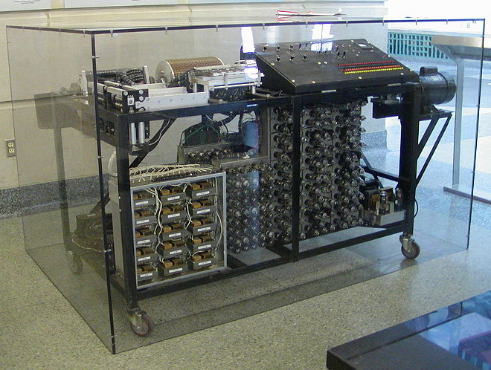
Atanasoff-Berry Linear Equation Solver (1939)
Fixed-function calculator for solving up to 29 simultaneous linear equations
Digital binary arithmetic (50-bit fixed-point words)
Dynamic memory (rotating drum of capacitors)
Vacuum tube logic for processing
In 1973, Atanasoff was credited as inventor of “automatic electronic digital computer” after patent dispute with Eckert and Mauchly (ENIAC)
[Manop, Creative Commons BY-SA 3.0 ]

Slide 25
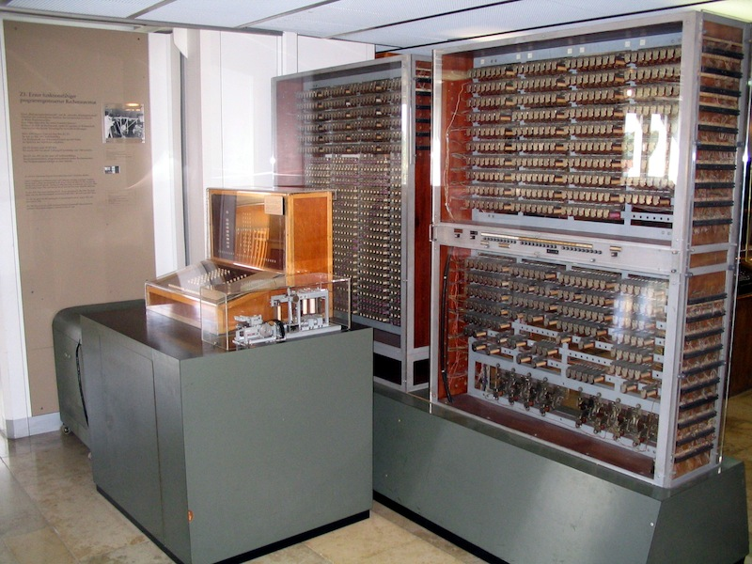
Zuse Z3 (1941)
Built by Konrad Zuse in wartime Germany using 2000 relays
Had normalized floating-point arithmetic with hardware handling of exceptional values (+/- infinity, undefined)
1-bit sign, 7-bit exponent, 14-bit significand
64 words of memory
Two-stage pipeline 1) fetch&execute 2) writeback
No conditional branch
Programmed via paper tape
Replica of the Zuse Z3 in the Deutsches Museum, Munich
[Venusianer, Creative Commons BY-SA 3.0 ]

Slide 26
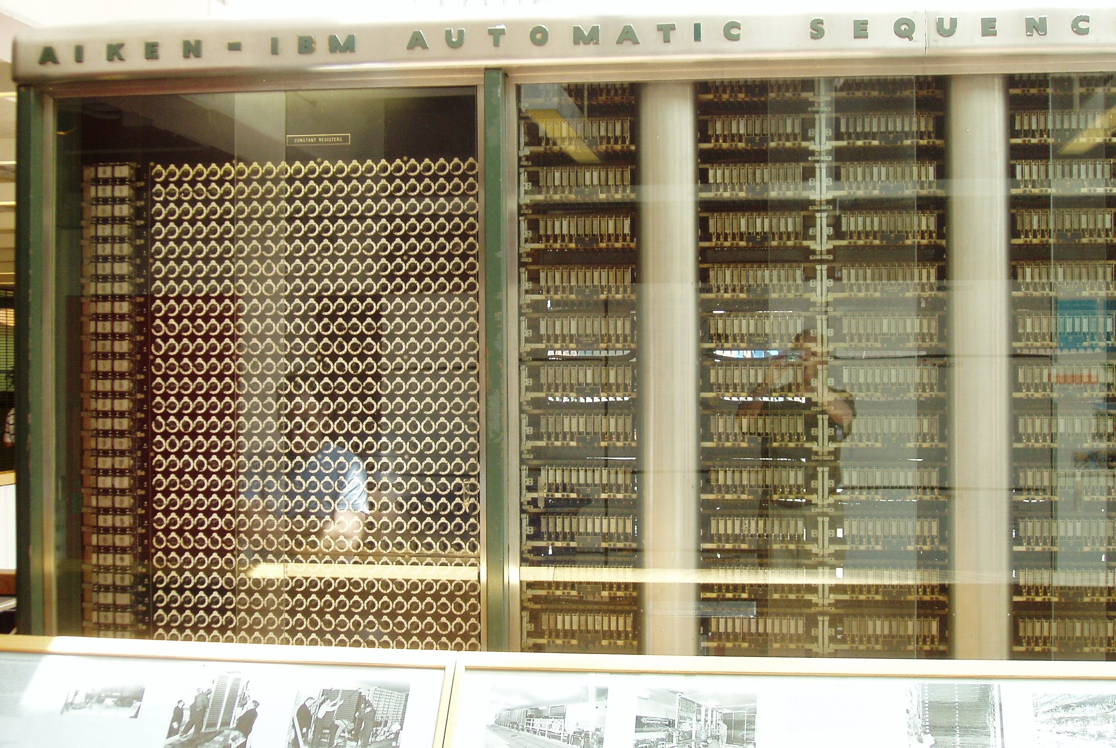
Harvard Mark I (1944)
Proposed by Howard Aiken at Harvard, and funded and built by IBM
Mostly mechanical with some electrically controlled relays and gears
Weighed 5 tons and had 750,000 components
Stored 72 numbers each of 23 decimal digits
Speed: adds 0.3s, multiplies 6s, divide 15s, trig >1 minute
Instructions on paper tape (2-address format)
Could run long programs automatically
Loops by gluing paper tape into loops
No conditional branch
Although mentioned Babbage in proposal, was more limited than analytical engine
[Waldir, Creative Commons BY-SA 3.0 ]

Slide 27
ENIAC (1946)
First electronic general-purpose computer
Construction started in secret at UPenn Moore School of Electrical Engineering during WWII to calculate firing tables for US Army, designed by Eckert and Mauchly
17,468 vacuum tubes
Weighed 30 tons, occupied 1800 sq ft, power 150kW
Twelve 10-decimal-digit accumulators
Had a conditional branch!
Programmed by plugboard and switches, time consuming!
Purely electronic instruction fetch and execution, so fast
10-digit x 10-digit multiply in 2.8ms (2000x faster than Mark-1)
As a result of speed, it was almost entirely I/O bound
As a result of large number of tubes, it was often broken (5 days was longest time between failures)

Slide 28

ENIAC
Changing the program could take days!
[Public Domain, US Army Photo]

Slide 29
EDVAC
ENIAC team started discussing stored-program concept to speed up programming and simplify machine design
John von Nuemann was consulting at UPenn and typed up ideas in “First Draft of a report on EDVAC”
Herman Goldstine circulated the draft June 1945 to many institutions, igniting interest in the stored-program idea
But also, ruined chances of patenting it
Report falsely gave sole credit to von Neumann for the ideas
Maurice Wilkes was excited by report and decided to come to US workshop on building computers
Later, in 1948, modifications to ENIAC allowed it to run in stored-program mode, but 6x slower than hardwired
Due to I/O limitations, this speed drop was not practically significant and improvement in productivity made it worthwhile
EDVAC eventually built and (mostly) working in 1951
Delayed by patent disputes with university

Slide 30
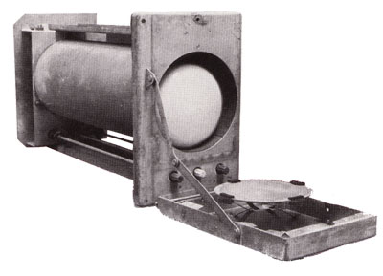
Manchester SSEM “Baby” (1948)
Manchester University group build small-scale experimental machine to demonstrate idea of using cathode-ray tubes (CRTs) for computer memory instead of mercury delay lines
Williams-Kilburn Tubes were first random access electronic storage devices
32 words of 32-bits, accumulator, and program counter
Machine ran world’s first stored-program in June 1948
Led to later Manchester Mark-1 full-scale machine
Mark-1 introduced index registers
Mark-1 commercialized by Ferranti
[Piero71, Creative Commons BY-SA 3.0 ]
Williams-Kilburn Tube Store

Slide 31
Cambridge EDSAC (1949)
Maurice Wilkes came back from workshop in US and set about building a stored-program computer in Cambridge
EDSAC used mercury-delay line storage to hold up to 1024 words (512 initially) of 17 bits (+1 bit of padding in delay line)
Two’s-complement binary arithmetic
Accumulator ISA with self-modifying code for indexing
David Wheeler, who earned the world’s first computer science PhD, invented the subroutine (“Wheeler jump”) for this machine
Users built a large library of useful subroutines
UK’s first commercial computer, LEO-I (Lyons Electronic Office), was based on EDSAC, ran business software in 1951
Software for LEO was still running in the 1980s in emulation on ICL mainframes!
EDSAC-II (1958) was first machine with microprogrammed control unit

Slide 32
Commercial computers: BINAC (1949) and UNIVAC (1951)
Eckert and Mauchly left U.Penn after patent rights disputes and formed the Eckert-Mauchly Computer Corporation
World’s first commercial computer was BINAC with two CPUs that checked each other
BINAC apparently never worked after shipment to first (only) customer
Second commercial computer was UNIVAC
Used mercury delay-line memory, 1000 words of 12 alpha characters
Famously used to predict presidential election in 1952
Eventually 46 units sold at >$1M each
Often, mistakingly called the IBM UNIVAC

Slide 33
IBM 701 (1952)
IBM’s first commercial scientific computer
Main memory was 72 William’s Tubes, each 1Kib, for total of 2048 words of 36 bits each
Memory cycle time of 12µs
Accumulator ISA with multipler/quotient register
18-bit/36-bit numbers in sign-magnitude fixed-point
Misquote from Thomas Watson Sr/Jr:
“I think there is a world market for maybe five computers”
Actually TWJr said at shareholder meeting:
“as a result of our trip [selling the 701], on which we expected to get orders for five machines, we came home with orders for 18.”

Slide 34
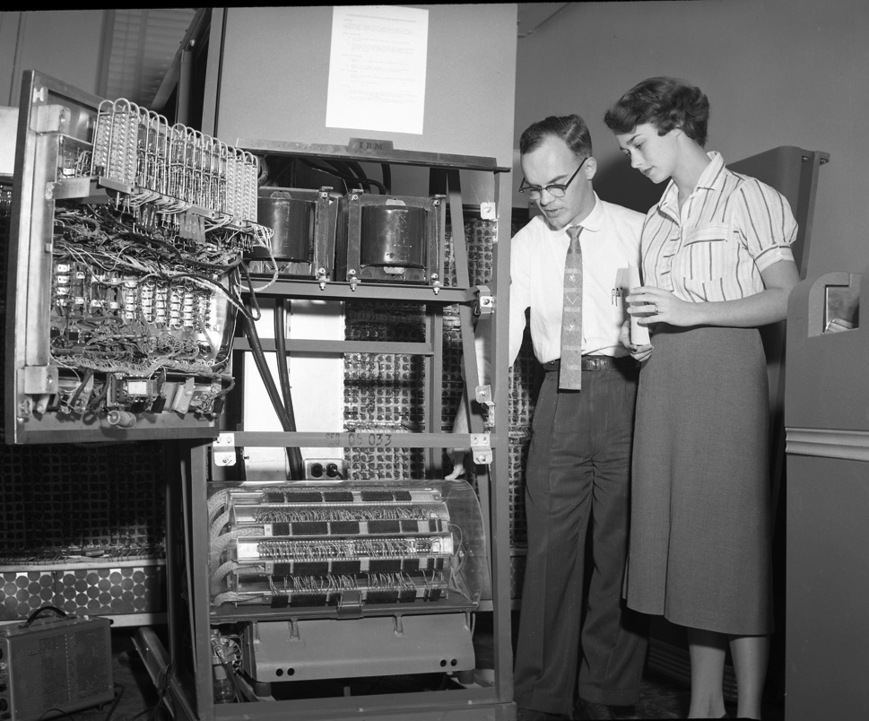
IBM 650 (1953)
The first mass-produced computer
Low-end system with drum-based storage and digit serial ALU
Almost 2,000 produced
[Cushing Memorial Library and Archives, Texas A&M,
Creative Commons Attribution 2.0 Generic ]

Slide 35
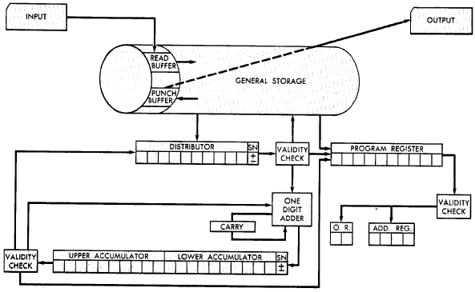
IBM 650 Architecture
Magnetic Drum (1,000 or 2,000
10-digit decimal words)
Active instruction (including next program counter)
Digit-serial ALU
20-digit accumulator
[From 650 Manual, © IBM]

Slide 36
IBM 650 Instruction Set
Address and data in 10-digit decimal words
Instructions encode:
Two-digit opcode encoded 44 instructions in base instruction set, expandable to 97 instructions with options
Four-digit data address
Four-digit next instruction address
Programmer’s arrange code to minimize drum latency!
Special instructions added to compare value to all words on track

Slide 37
Early Instruction Sets
Very simple ISAs, mostly single-address accumulator-style machines, as high-speed circuitry was expensive
Based on earlier “calculator” model
Over time, appreciation of software needs shaped ISA
Index registers (Kilburn, Mark-1) added to avoid need for self-modifying code to step through array
Over time, more index registers were added
And more operations on the index registers
Eventually, just provide general-purpose registers (GPRs) and orthogonal instruction sets
But some other options explored…

Slide 38
Burrough’s B5000 Stack Architecture: Robert Barton, 1960
Hide instruction set completely from programmer using high-level language (ALGOL)
Use stack architecture to simplify compilation, expression evaluation, recursive subroutine calls, interrupt handling,…

Slide 39
Evaluation of Expressions
(a + b * c) / (a + d * c - e)
/
+
-
a
*
+
e
b
c
a
*
d
c
c
*
b * c
b
Reverse Polish
a b c * + a d c * + e - /
a
Evaluation Stack
push a
push b
push c
multiply

Slide 40
Evaluation of Expressions
(a + b * c) / (a + d * c - e)
/
+
-
a
*
+
e
b
c
a
*
d
c
b * c
Reverse Polish
a b c * + a d c * + e - /
+
a + b * c
a
Evaluation Stack
add

Slide 41
IBM’s Big Bet: 360 Architecture
By early 1960s, IBM had several incompatible families of computer:
701 → 7094
650 → 7074
702 → 7080
1401 → 7010
Each system had its own
Instruction set
I/O system and secondary storage (magnetic tapes, drums and disks)
assemblers, compilers, libraries,...
market niche (business, scientific, real time, ...)

Slide 42
IBM 360 : Design Premises Amdahl, Blaauw and Brooks, 1964
The design must lend itself to growth and successor machines
General method for connecting I/O devices
Total performance - answers per month rather than bits per microsecond → programming aids
Machine must be capable of supervising itself without manual intervention
Built-in hardware fault checking and locating aids to reduce down time
Simple to assemble systems with redundant I/O devices, memories etc. for fault tolerance
Some problems required floating-point larger than 36 bits

Slide 43
Stack versus GPR Organization Amdahl, Blaauw and Brooks, 1964
1. The performance advantage of push-down stack organization is derived from the presence of fast registers and not the way they are used.
2.“Surfacing” of data in stack which are “profitable” is approximately 50% because of constants and common subexpressions.
3. Advantage of instruction density because of implicit addresses is equaled if short addresses to specify registers are allowed.
4. Management of finite-depth stack causes complexity.
5. Recursive subroutine advantage can be realized only with the help of an independent stack for addressing.
6. Fitting variable-length fields into fixed-width word is awkward.

Slide 44
IBM 360: A General-Purpose Register (GPR) Machine
Processor State
16 General-Purpose 32-bit Registers
may be used as index and base register
Register 0 has some special properties
4 Floating Point 64-bit Registers
A Program Status Word (PSW)
PC, Condition codes, Control flags
A 32-bit machine with 24-bit addresses
But no instruction contains a 24-bit address!
Data Formats
8-bit bytes, 16-bit half-words, 32-bit words, 64-bit double-words
The IBM 360 is why bytes are 8-bits long today!

Slide 45
IBM 360: Initial Implementations
Model 30 . . . Model 70
Storage 8K - 64 KB 256K - 512 KB
Datapath 8-bit 64-bit
Circuit Delay 30 nsec/level 5 nsec/level
Local Store Main Store Transistor Registers
Control Store Read only 1sec Conventional circuits
IBM 360 instruction set architecture (ISA) completely hid the underlying technological differences between various models.
Milestone: The first true ISA designed as portable hardware-software interface!
With minor modifications it still survives today!

Slide 46
IBM Mainframes survive until today
[z14, 2017, 14nm technology, 17 layers of metal, 696 sq mm]

Slide 47
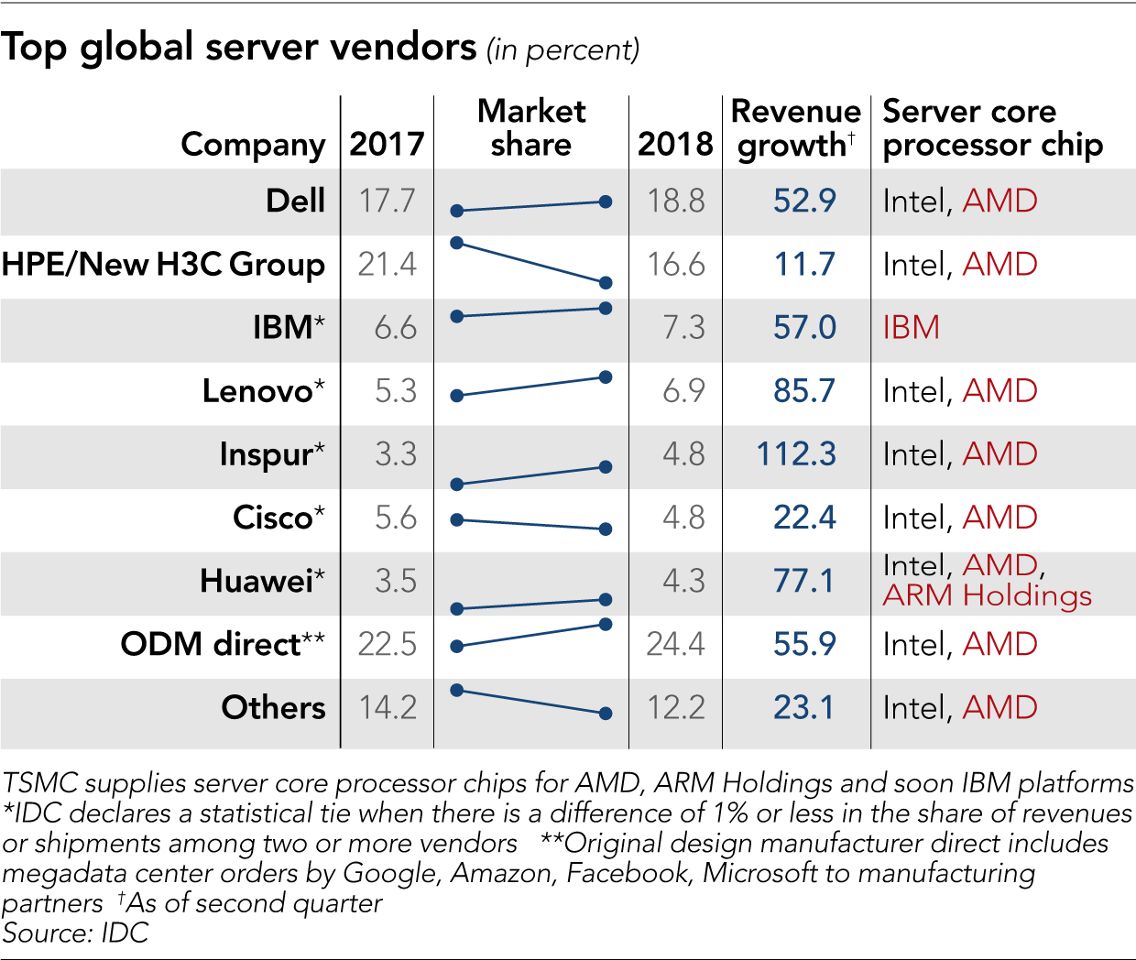
Server Market

Slide 48
And in conclusion …
Computer Architecture >> ISAs and RTL
COMP 590 is about interaction of hardware and software, and design of appropriate abstraction layers
Computer architecture is shaped by technology and applications
History provides lessons for the future
Computer Science at the crossroads from sequential to parallel computing
Salvation requires innovation in many fields, including computer architecture
Read Chapter 1 & Appendix A for next time!

Slide 49
Acknowledgements
These slides contain material developed and copyright by:
Arvind (MIT)
Krste Asanovic (MIT/UCB)
Joel Emer (Intel/MIT)
James Hoe (CMU)
John Kubiatowicz (UCB)
David Patterson (UCB)
Mike Ferdman (SBU)
Donald E. Porter (UNC/SBU)
MIT material derived from course 6.823
UCB material derived from course CS252

